Slide 1
Compiler Design
Resource Hacker
Saeed Parsa
Presenters:
Amir Hossein Ahmadi, Melika Ahmadi Ranjbar
Mohamad Hossein Karimian, Mohamad Ali Farahat
School of Computer Engineering,
Iran University of Science & Technology
Spring 2021

Slide 2
What is Resource Hacker?
Resource Hacker is a small but excellent tool to modify system files like DLL, EXE, CPL, etc. You can even change Windows look by editing various Windows files and replacing their resources using Resource Hacker.
You can download it using following link: http://www.angusj.com/resourcehacker/#download
In this presentation, we will help you in understanding this tool and will teach you how to use it. For your convenience, we have divided this presentation in 2 parts:
PART1: BASIC INFORMATION
PART2: ADVANCED INFORMATION
Part 1 provides basic details like viewing or replacing existing resources in a file, etc. Part 2 covers some advance information for geeks, like adding new resources, using scripts, etc.

Slide 3
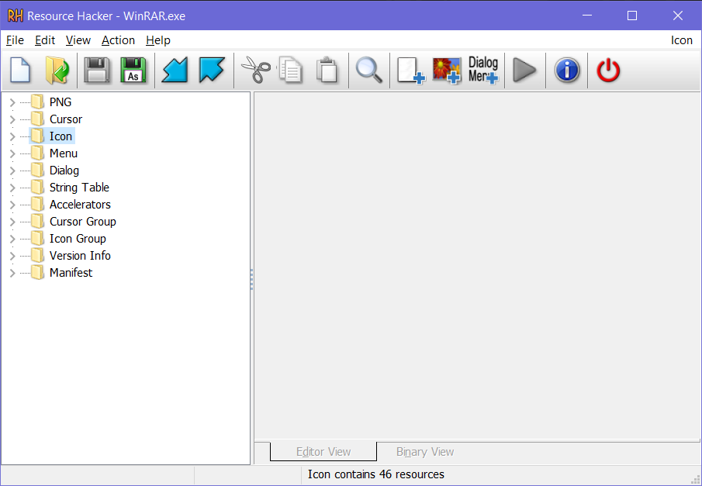
Part1: Basic information
Using Resource Hacker
When you open a file in Resource Hacker, it shows various directories in left-side pane, like:
AVI - Contains AVI files
Cursor - Contains Cursor files
Bitmap - Contains BMP files
Icon - Contains Icons
Menu - Contains Menus
Dialog - Contains Dialog boxes
String Table - Contains Strings
Accelerators - Contains Shortcut keys
Version Info - Contains Version information of the file

Slide 4
Part1: Basic information
Viewing Resources
You can view resource present in the file by expanding the directory given in left-side pane and clicking on the name of the resource. Each resource contains 3 important attributes:
Resource Type
Resource Name
Resource Language

Slide 5
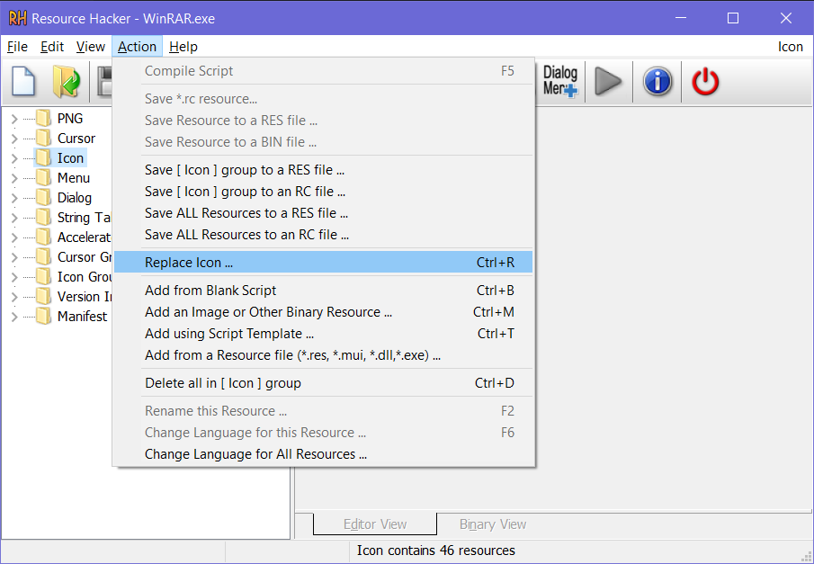
Part1: Basic information
Changing Resources
For Icons / Cursors / Bitmaps:
1. First select the resource ( e.g. Bitmap -> 131 -> 1033 ).
2. Now click on Action -> Replace Icon / Cursor / Bitmap option or right-click on the resource and select the Replace option.
3. It'll open a new window, click on Open file with new Icon or Cursor or Bitmap button.
4. Select the desired resource using OPEN dialog box, click on Open button and then click on Replace button.

Slide 6
Part1: Basic information
Changing Resources
For Other Resources like AVI:
1. Select the AVI resource and click on Action -> Replace Resource option or right-click on the AVI resource and select the Replace option.
2. It’ll open a new window, click on Open file with new resource button (or Select File button in newer versions).
3. Select the file and click on Open button.
4. Now you’ll need to provide following required information for the resource, which we mentioned earlier:
Resource Type: Mention type of the resource, e.g. if you are replacing AVI file, mention the type as AVI.
Resource Name: Provide the same name of the existing resource which you want to replace.
Resource Language: Provide language code for the resource, e.g. 1033 for English. You can check existing resource's language code.
5. At last click on Replace button.

Slide 7
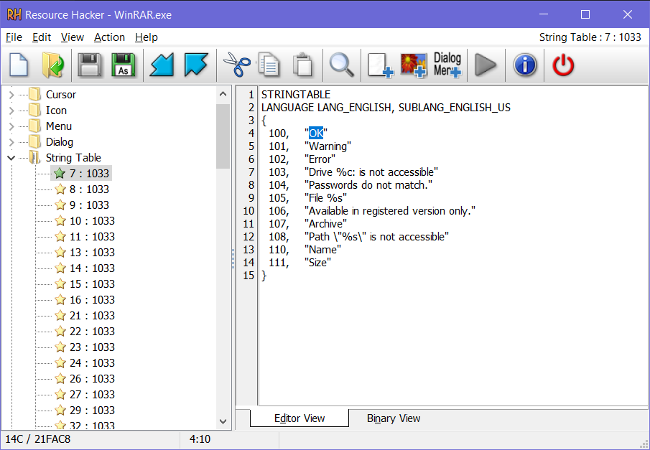
Part1: Basic information
Changing Resources
For Menus / Strings / Dialogs:
To change any String, Menu or Dialog box, Select the desired resource, e.g. String Table -> 4 -> 1033, make your changes and at last click on Compile Script button or press F5 key or click on Action -> Compile option.
It’ll immediately compile the script. If you made any mistake while modifying the resource, it’ll generate error message so that you can fix it.

Slide 8
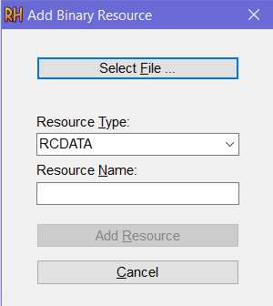
Part2: Advance information
Adding New Resources
Adding New Bitmaps / Icons / Cursors / AVIs:
1. Click on Action -> Add a new Resource option (or Action -> Add Single Binary or Image Resource option in newer versions).
2. Now click on Open file with new resource button (or Select File button in newer versions).
3. Select the desired resource and click on Open button.
4. Give Resource Type, Name and Language as mentioned earlier. But keep in mind that Resource Name should not match with any existing resources name.
5. At last click on Add Resource button.

Slide 9
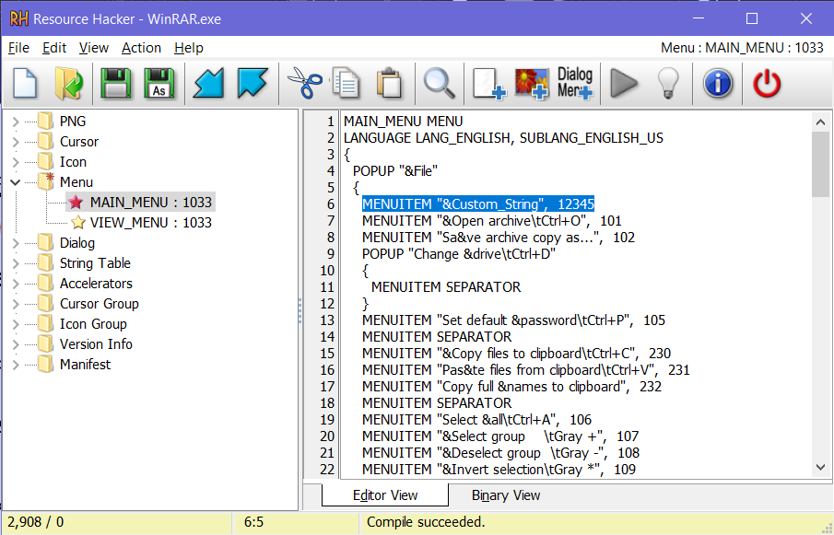
Part2: Advance information
Adding New Resources
Adding New Menus:
Go to desired menu, e.g. Menu -> 215 -> 1033. Now add a new line anywhere inside POPUP “” using following format:
MENUITEM “Custom_String“, 12345
Where:
“Custom_String” is the actual text which you want to show in menu.
12345 is the identifier. It must be different from existing menuitems.

Slide 10
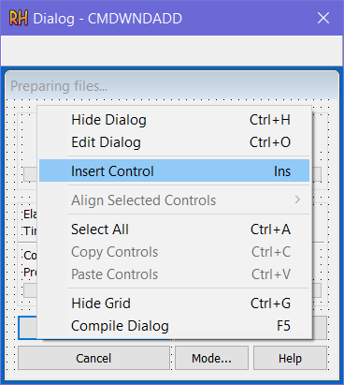
Part2: Advance information
Inserting Newly Added Resources in Dialog Boxes
Once you finish adding new Icons / Bitmaps / AVIs, you can insert them in any dialog box so that you can show in various Windows dialog boxes like RUN, Progress Dialog box, etc.
1. Go to the desired dialog box, e.g. Dialog -> 1020 -> 1033
2. Right-click in the dialog box and select Insert Control option.
3. It’ll open a new window. You’ll see many controls in the new
window, like BITMAP, LABEL, ICON, BUTTON, SysAnimate32
(for AVIs), etc.

Slide 11
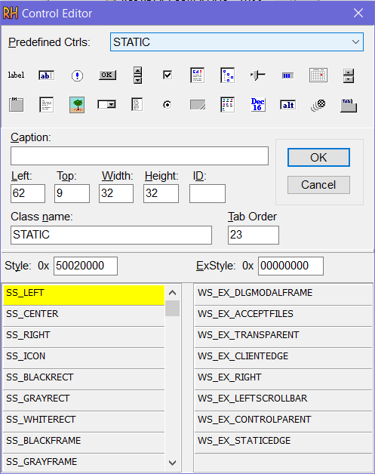
Part2: Advance information
Inserting Newly Added Resources in Dialog Boxes
...
4. Click on any desired control, e.g. to insert a Bitmap, click on the BITMAP control or to insert an AVI, click on SysAnimate32 control.
PS: You can also insert Date/Time in dialog box using SysDateTimePick32 control.
5. Don’t forget to fill the Caption entry. You need to enter the Resource Name in Caption textbox, e.g. if you have added a Bitmap and set its Resource Name as 401, then give the same 401 in Caption textbox.
PS: For AVI Control ( SysAnimate32 ), you’ll need to append # in Caption value, e.g if the AVI name is 144, then put #144 in Caption textbox.
6. At last click on OK button & then Compile the script.
7. If you want to change the position of the new control in dialog box, simply click on the control and drag it to your desired location or you can also use arrow keys to move it.

Slide 12

Thanks for your attention

